Slide 1
IMAGE PROCESSING USING WATERSHED SEGMENTATION
-Pratik Gupta(17100033)
-Prahlad Kumar(17100032)
Mentor:
Dr Anurag Singh

Slide 2
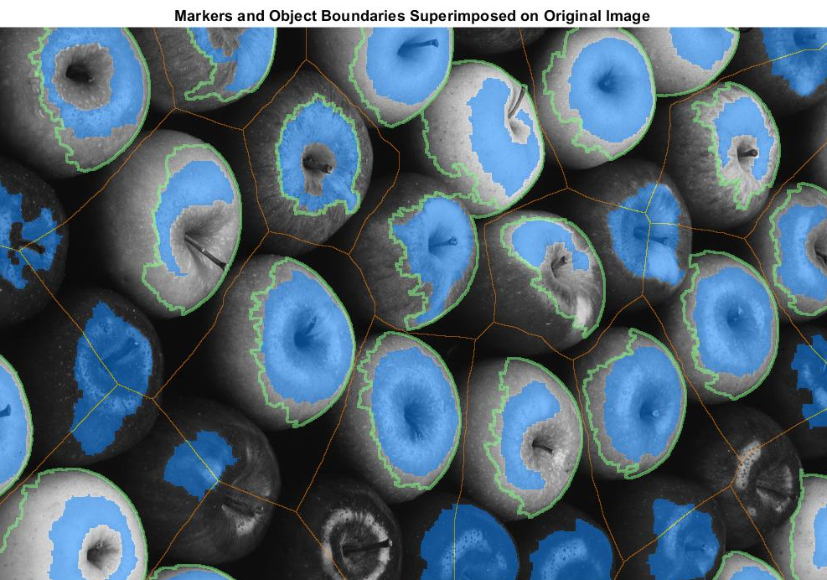
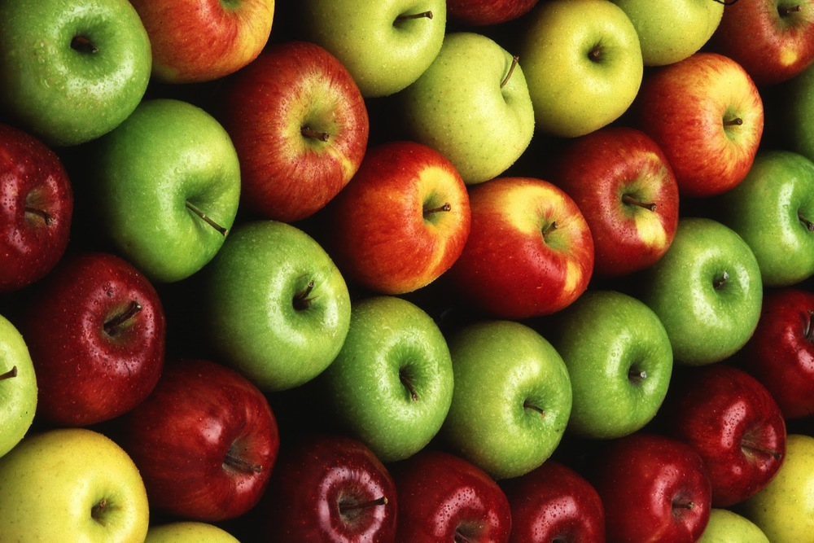
Objective
To separate round objects present in an image.

Slide 3
Motivation
To count the no. of round objects in an image.
The watershed transformation treats the image it operates upon like a topographic map, with the brightness of each point representing its height, and finds the lines that run along the tops of ridges.

Slide 4
Procedure
Compute a segmentation function. This is an image whose dark regions are the objects you are trying to segment.
Compute foreground markers. These are connected blobs of pixels within each of the objects.
Compute background markers. These are pixels that are not part of any object.
Modify the segmentation function so that it only has minima at the foreground and background marker locations.
Compute the watershed transform of the modified segmentation function.

Slide 5
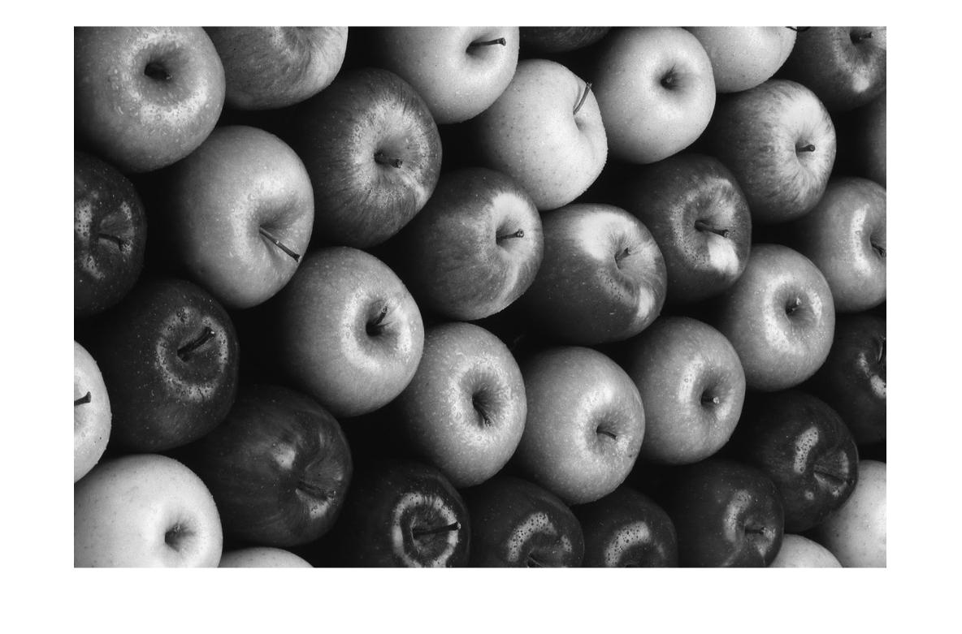
Open and convert to Grayscale

Slide 6
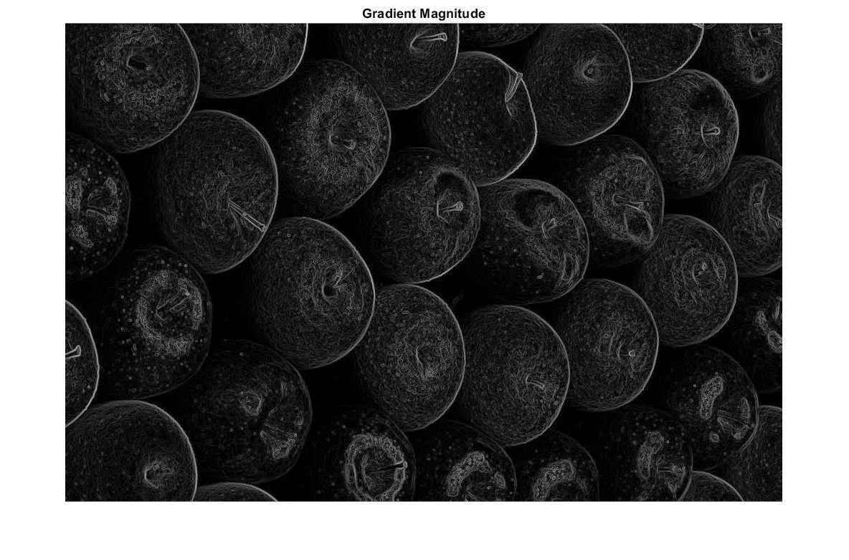
Compute a segmentation function
Use the gradient function as segmentation function
The gradient is high at the borders of the objects and low (mostly) inside the objects

Slide 7
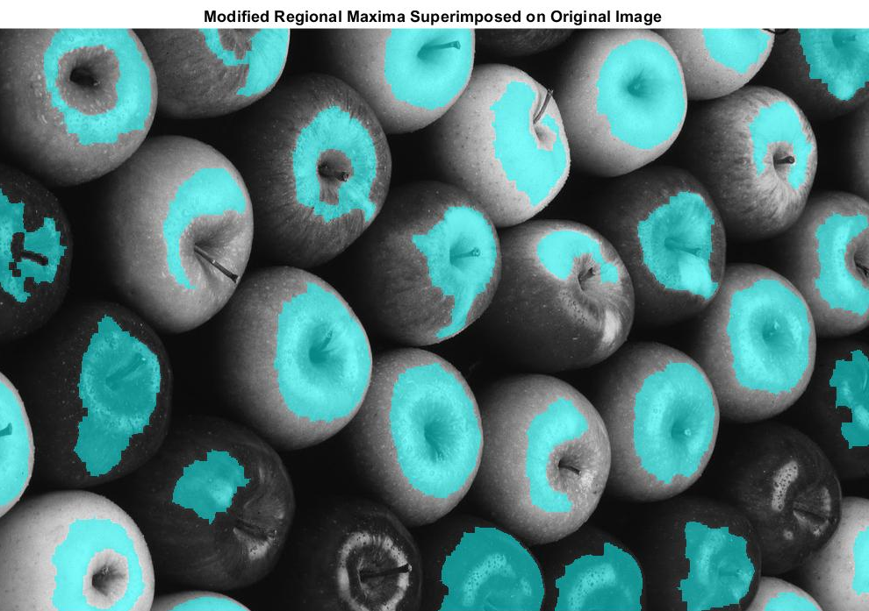
Mark the foreground objects

Slide 8
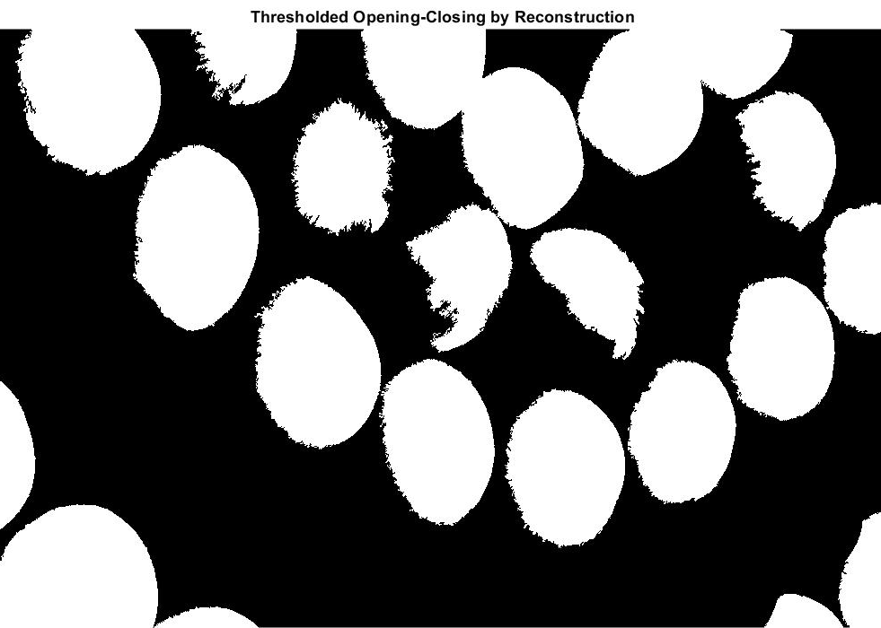
Compute the background markers

Slide 9
Compute the watershed transform of segmentation function

Slide 10
Result

Slide 11
Applications
Diagnosis
Computer Integrated Surgery
Image Enhacement

